Slide 1
JavaScript & TypeScript NXT
@basarat

Slide 2
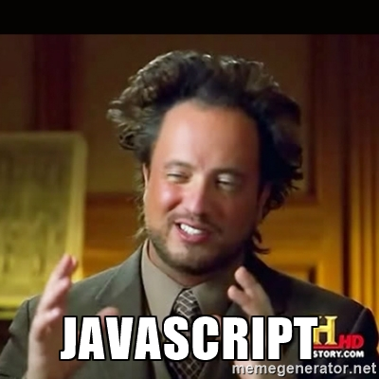

Slide 3
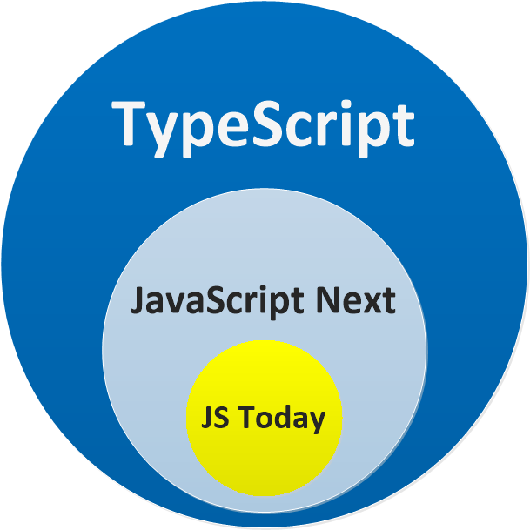

Slide 4
DEMO
Just a JS file

Slide 6


Slide 7


Slide 10
QUESTIONS

Slide 11


alm.tools
Google:
TypeScript Book

Slide 12
@basarat

